Slide 1
Lecture 13
Blueprints in Action 4

Slide 2
Lecture Goals and Outcomes
The goals of this lecture are to
Present more Blueprint functions
Show how to use the Add Child Actor Component function
Explain the AI MoveTo function
Show how to execute a console command in Blueprint
By the end of this lecture you will be able to
Identify an Actor by a tag
Apply damage to an Actor
Use the Add Child Actor Component function
Create simple AI that moves in the Level

Slide 3
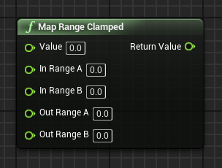
Map Range Clamped
The Map Range Clamped function converts a value from one range of values to the corresponding value in another range of values. The end result will always be in the output value range.
Input
Value: Original value to be converted.
In Range A: Minimum value of the input value range.
In Range B: Maximum value of the input value range.
Out Range A: Minimum value of the output value range.
Out Range B: Maximum value of the output value range.
Output
Return Value: Converted value in the output value range.

Slide 4
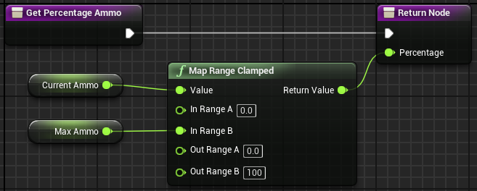
Map Range Clamped: example
In the example on the right, the Get Percentage Ammo function converts the current amount of the player’s ammo into a percentage that is displayed on the screen.
The calculation is based on variables that hold the maximum ammunition that the player can have and the current amount of ammunition.

Slide 5
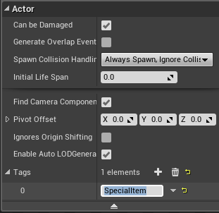
Actor Has Tag
The Actor Has Tag function checks to see if a game Actor has a certain tag. The use of tags is a simple way to differentiate Actors in the Level. The image on the right shows that a tag called “SpecialItem” has been added to an Actor.
Input
Target: Actor reference that will be used in the tag verification.
Tag: Tag that will be used in the test.
Output
Return Value: Boolean value. If the value is “true”, the Actor has the specified tag.

Slide 6
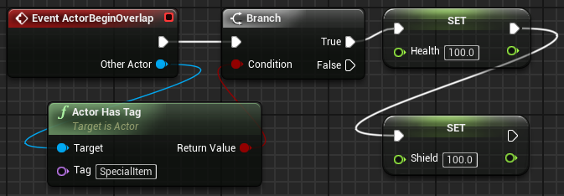
Actor Has Tag: example
In the example on the right, the Actor Has Tag function is used to check if the Actor that was overlapped by the player has the SpecialItem tag.
If it does, then the health and shield of the player are restored by setting their values to “100.0”.

Slide 7
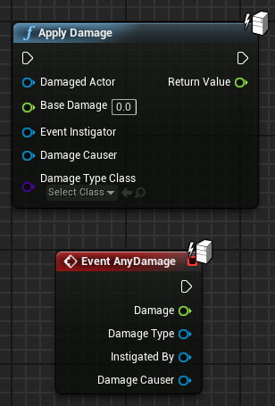
Apply Damage
The Apply Damage function is used to apply damage to an Actor. Information related to the damage can be passed through the function. The hit Actor responds to the damage using the AnyDamage event, but the event only fires if the value of the Apply Damage node’s Base Damage parameter is different from “0.0”.
Input
Damaged Actor: Reference to the Actor who will suffer the damage.
Base Damage: Float value that represents the damage.
Event Instigator: Reference to the Controller responsible for causing the damage. Use of this parameter is optional.
Damage Causer: Reference to the Actor that caused the damage. Use of this parameter is optional.
Damage Type Class: Class that represents the type of damage done. Use of this parameter is optional.

Slide 8
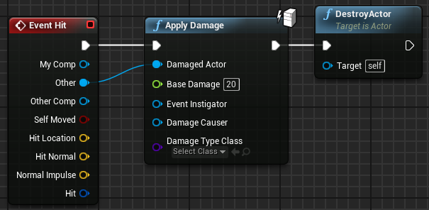
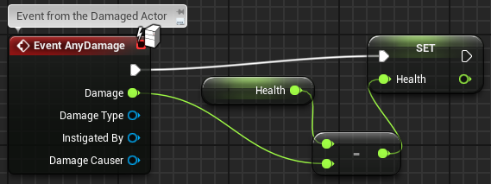
Apply damage: example
The script seen in the top image on the right can be used in a Blueprint that represents a bullet.
When the bullet hits an Actor, the Apply Damage function is used to apply damage with a value of “20”. After that, the bullet is destroyed.
The bottom image shows the AnyDamage event for the damaged Actor. It will decrease the value of the Health variable by the Damage value.

Slide 9
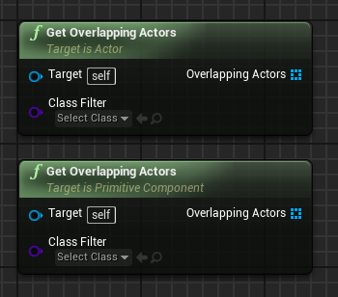
Get Overlapping Actors
The Get Overlapping Actors function returns a list of Actors that are overlapping the Actor/component. There are two versions of this function, one that uses an Actor as the target and the other that uses a component as the target.
Input
Target: Reference to the Actor/component that will be used in the overlapping test.
Class Filter: Indicates which class or subclasses will be used in the test. Use of this parameter is optional.
Output
Overlapping Actors: Array containing the Actors that are overlapping the Actor/component.

Slide 10
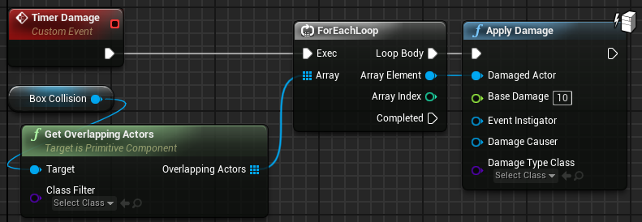
Get Overlapping Actors: example
Imagine an area that deals damage to all the Actors in it.
In the example on the right, this area is represented by a Blueprint that has a Box Collision component that defines the location where the Actors suffer damage.
The Timer Damage event is periodically called to apply damage to all Actors who are overlapping the Box Collision.

Slide 11
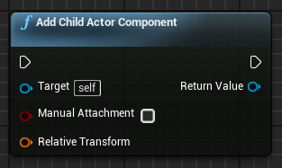
Add Child Actor Component
The Add Child Actor Component function adds an Actor as a component of another Actor. Thus the component Actor follows the transformations of the parent Actor. When the parent Actor is destroyed, the Actor component is also destroyed. The new Actor’s class must be specified in the Details panel of the Add Child Actor Component function.
Input
Target: Reference to the Actor who will own the new component.
Manual Attachment: Boolean value. If the value is “false”, the new Actor will be automatically attached.
Relative Transform: Transformation used by the new component.
Output
Return Value: Reference to the created Actor.

Slide 12
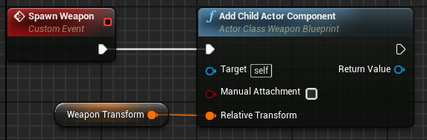

Add Child Actor Component: example
In the example on the right, there is a Blueprint named “WeaponBlueprint” that represents a weapon. In another Blueprint that represents a character in the game, there is an event that will be called during the game to add a weapon of type “WeaponBlueprint” to the character.
The bottom image is from the Details panel of the Add Child Actor Component function. It is displayed when the function is selected. The class that will be used by the new Actor must be specified in the Child Actor Class property field.

Slide 13
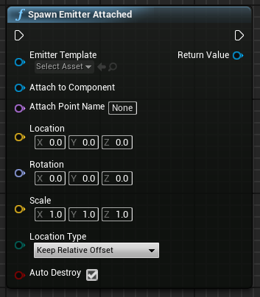
Spawn Emitter attached
The Spawn Emitter Attached function plays a Particle System and attaches it to a component.
Input
Emitter Template: Particle System template that will be used.
Attach to Component: Reference to a component.
Attach Point Name: Name of the socket where the emitter will be attached. Use of this parameter is optional.
Location, Rotation, Scale: World or relative transform depending on the value of Location Type.
Location Type: World or relative location.
Auto Destroy: Boolean value. If the value is “true”, the Particle System will be destroyed when execution is complete.

Slide 14
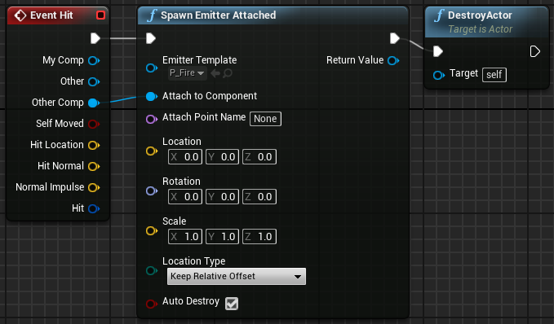
Spawn Emitter attached: example
The image on the right is from a Blueprint that represents a bullet.
When the bullet collides with something, a Particle System will be created using the P_Fire template and will be attached to the component that was hit.
After that, the bullet will be destroyed.

Slide 15
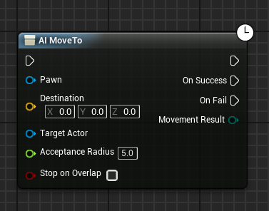
Ai move to
The AI MoveTo node is used to move a Pawn. The destination can be a location or another Actor. The Level must have a Nav Mesh Bounds Volume to define the area that the AI MoveTo action can use. It is a latent action, so it runs in parallel to the normal flow of execution of the Blueprints.

Slide 16
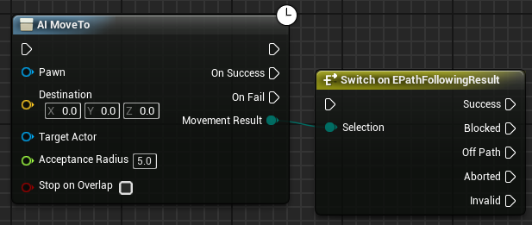
Ai move to: input and output
Input
Pawn: Reference to the Pawn that will be moved.
Destination: Vector indicating the destination.
Target Actor: Reference to an Actor that will be continuously tracked.
Acceptance Radius: Maximum destination distance to complete movement.
Stop on Overlap: Boolean value. If the value is “true”, the move will be complete as soon as the Pawn begins to overlap the acceptance radius.
Output
On Success: Exec pin that will be executed when the AI MoveTo function reaches its goal.
On Fail: Exec pin that will be executed if the AI MoveTo function cannot reach its goal.
Movement Result: Enumeration with the following possible result: “Success”, “Blocked”, “Off Path”, “Aborted”, or “Invalid”.

Slide 17
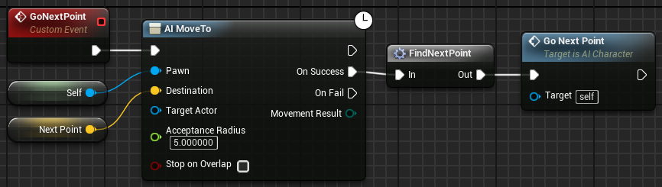
Ai move to: example
In the example on the right, the AI MoveTo node is being used to direct a Pawn to follow a path represented by a set of predefined points in the Level. These points representing the path may be stored in an array. The FindNextPoint macro is responsible for picking the next point on the path and storing it in the Next Point variable.
The clock icon indicates that AI MoveTo is a latent action. The GoNextPoint event initiates the AI MoveTo action, but the actions connected to the On Success pin will be performed only when the Pawn reaches its destination. After the FindNextPoint macro updates the Next Point variable, the GoNextPoint event is called again.

Slide 18
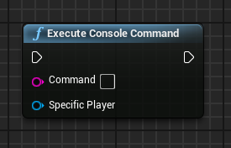
Execute Console Command
The Execute Console Command function allows the execution of a console command.
Console commands are text-based commands that can be executed in the Editor or in the game.
Input
Command: Console command that will be executed.
Specific Player: Reference to a Player Controller that will receive the command. Use of this parameter is optional.

Slide 19
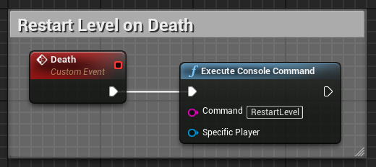
Execute Console Command: example
In a simple game, the Level will be restarted when the player dies. In the example on the right, this is done using a custom event named “Death” that executes the console command “RestartLevel”.
For a complete list of console commands, open the Output Log window (Window > Developer Tools > Output Log). The line at the bottom of the window is for entering console commands. Enter the “DumpConsoleCommands” command and press the Enter key to get the list of commands.

Slide 20
summary
This lecture presented more Blueprint functions. It also showed how to use the Add Child Actor Component and the AI MoveTo functions and how to execute a console command in Blueprint.

